Slide 1
Hidden Markov models in marine sciences
Ron Togunov, Marie Auger-Méthé
Notes:
Hi, my name is Ron Togunov, and I’m a recent PhD graduate from the University of British Columbia, supervised by Marie Auger-Méthé
I'm helping organize this workshop for DFO focused on Hidden Markov models and specifically their application in marine sciences.
This workshop will be composed of three lectures presenting the theoretical background of HMM and three 3-hour tutorials that we will work on together over zoom to apply the theory to real animal tracking data.

Slide 2
HMM OUTLINE
Ecological motivation
Statistical framework
Mixture models
Markov chains
HMMs
Polar bear case study
Notes:
In this presentation, I will briefly discuss the Ecological motivations for HMMs, their statistical framework, in which mixture models and Markov chains combine to make HMMs.
I conclude the talk by presenting my PhD work on polar bear behaviour as a case study.
This workshop

Slide 3
Motivation

Slide 4
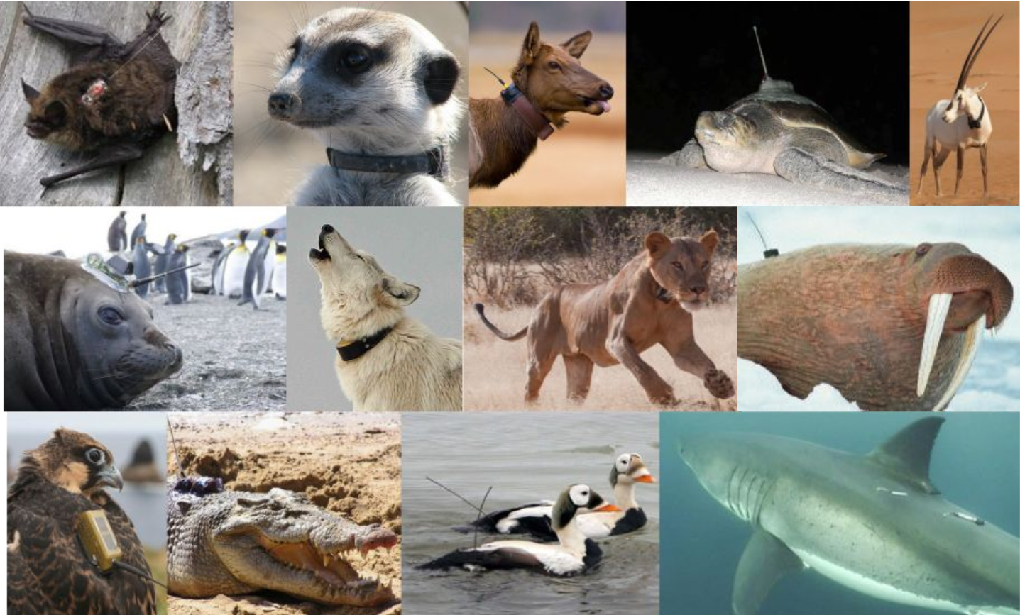
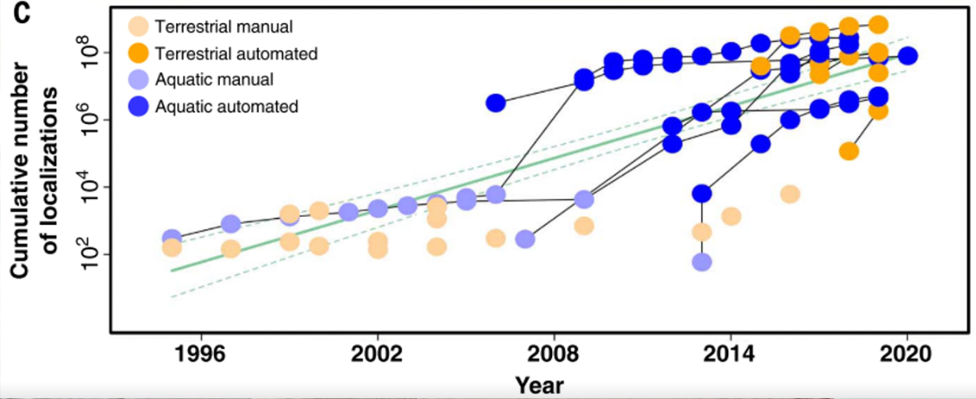
4
Nathan et al, 2022
Photos: A. Park, C. Franklin, P. Lopez, N. Papathanasopoulou, R. Cameron, S. Anderson, R. Schuckard, L. Thorngren, L. Boehme,C. Jay
Notes:
over the past several decades, we've been collecting more and more remote biotelemetry from animals.
This includes movement data such as the animal’s geographic location, elevation, depth, accelerometer data, orientation relative to the poles,
As well as physiological data such as body temperature, and heart-rate
The overall amount of data collected in both terrestrial and marine systems has been growing exponentially

Slide 5
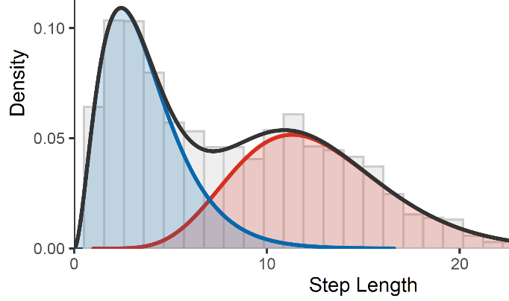
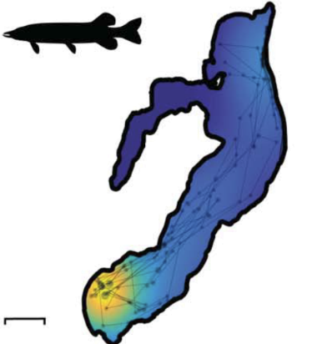
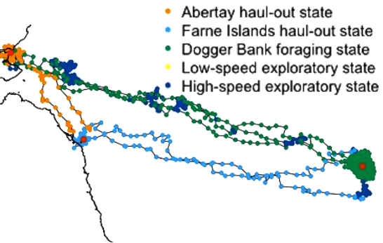
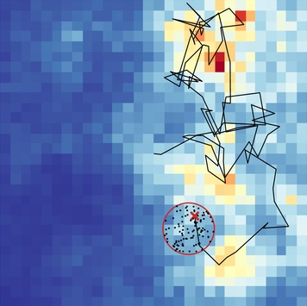
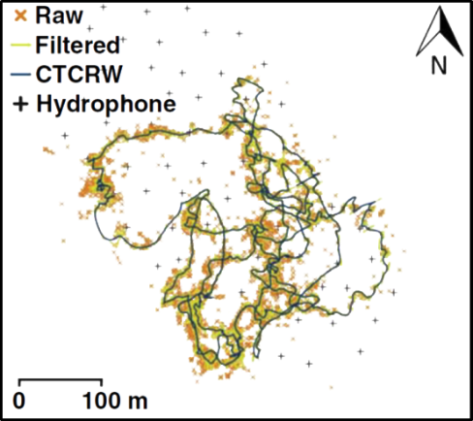
Movement modelling
i
Movement parameter estimation
Nathan et al, 2022
Home range estimation
Behaviour segmentation
Habitat & resource selection
Michelot et al. 2017
Path reconstruction
Michelot et al. 2017
Nathan et al, 2022
Notes:
there are many possible avenues to investigate this data.
1. For example, with respect to movement data, we may be interested in estimating an animal's home range; where they are geographically in space, and where their distribution is concentrated.
2. Second, we may be interested in habitat and resource selections, where we want to identify what kind of environmental conditions do animals select for, for example bathymetry, sea surface temperature, or chlorophyll concentrations.
3. Next, we may be interested in parameterizing the animals’ movement characteristics. For example, this case the graph shows the distribution of step length for two different behaviors.
4. 4th, we may be interested segmenting the telemetry data into discrete behavioral States and identifying when and where those occur or under which conditions
5. last, if the data has high error or if we have missing records, we may be interested in path reconstruction to determine the most likely paths of the animals and where they may have been over time
Hidden Markov models address two of these components: movement parameter estimation, and behavior segmentation
And in this this workshop, we will also learn some basic methods for path reconstruction.

Slide 6
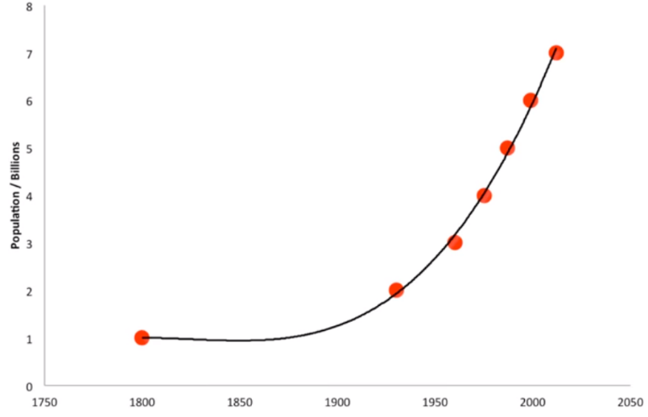
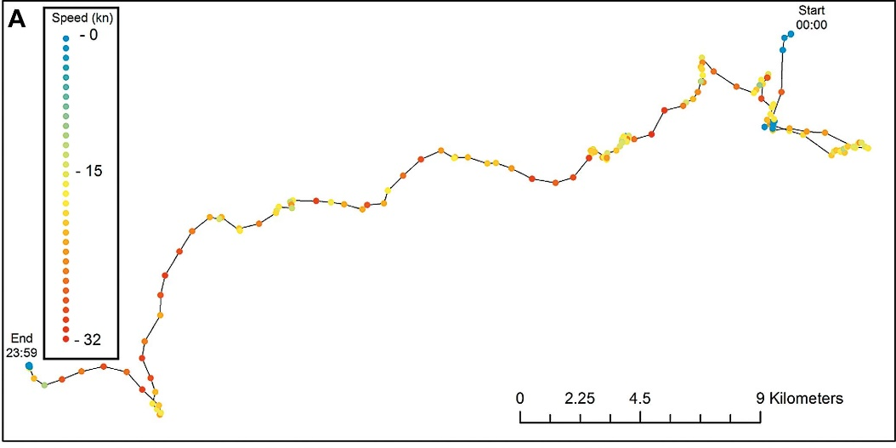


Hidden Markov models: Motivation
Underlying biological process is hidden
Observation is conditional on latent process
Population size vs sample
Behaviour state vs location data
Latent process is autocorrelated
State at one time depends on the previous time
Michelot et al. 2017
Notes:
So hidden Markov models have two components addressing two fundamental challenges when using telemetry data to identify behavioral states.
The first challenge is that the underlying biological process that researchers are interested in is not directly observed.
That is, the data stream we obtain is an indirect measure of that underlying behavioral process,
Such that observation data conditionally dependent on a latent state process.
For example, if me use catch data to estimate the stock size of a fish species, the true population is hidden. a second example, and the primary focus of this Workshop is using observed movement data to infer an unobserved (or latent) animal behaviour
The second challenge is that latent state process is also autocorrelated in time.
For example, the stock population size in one year is partly dependent on the population in the previous year,
and animal behavior at one time depends on what it was doing previously.
In effect our observation data is autocorrelated through a latent state process.

Slide 7
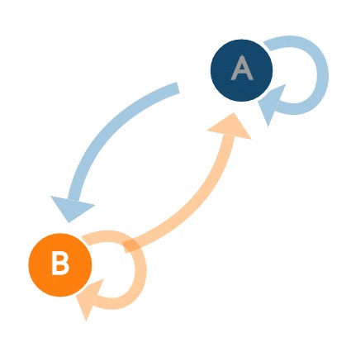

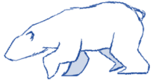
Hidden Markov models - Solution
Underlying biological process is hidden
Finite mixture model
Latent process is autocorrelated
Markov chain
Notes:
Hidden Markov models address these challenges by combining two different statistical tools.
For the hidden underlying process, we have finite mixture models.
in the graph on the right, the red line represents the overall observation data, and this data is emergent from several hidden processes represented by the blue curves.
To model the autocorrelation, HMMs describe the probability of the latent states using Markov chains, which say that the probability of being in a state at some time depends on what state you were in in the previous time.
In the Markov chain, there is a probability of staying within the same state, and a probability of transitioning to the another states.
Next, we’ll go into both of these components in more detail then discuss how they are combined into the Hidden Markov model.

Slide 8
FINITE MIXTURE MODELS
Notes:
First, let’s describe the theory behind finite mixture models ignoring autocorrelation.

Slide 9
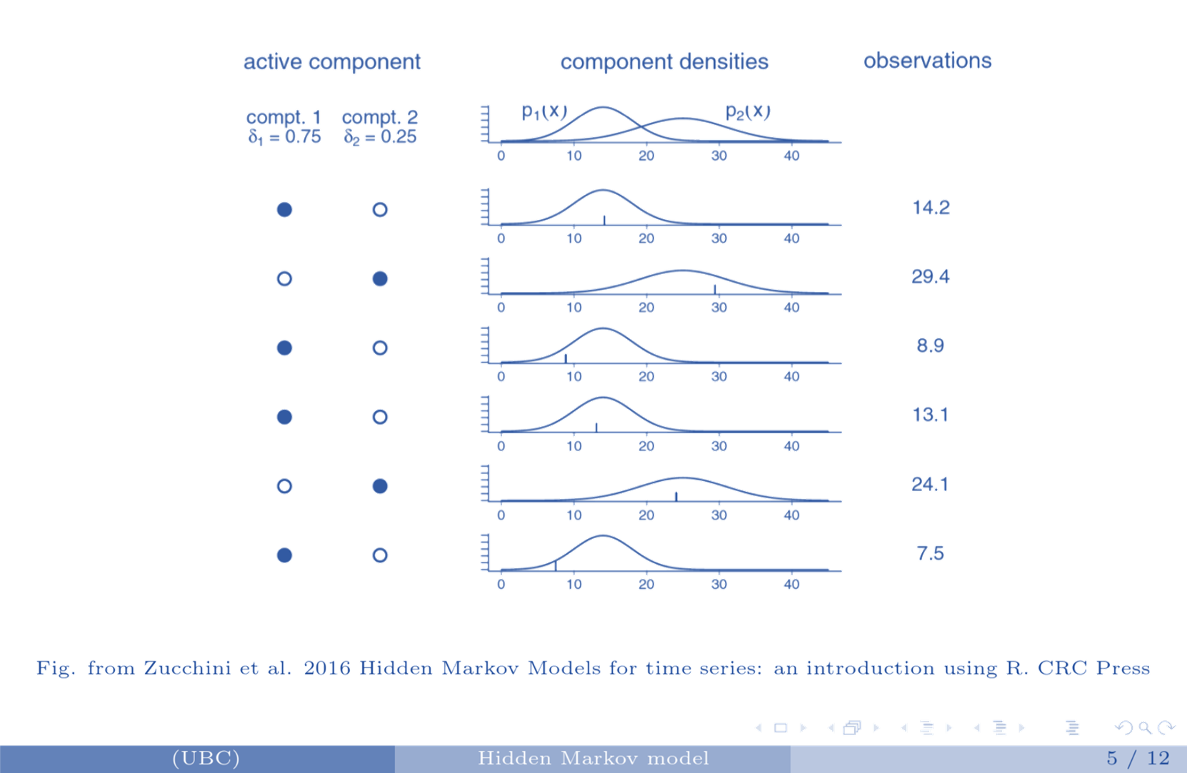
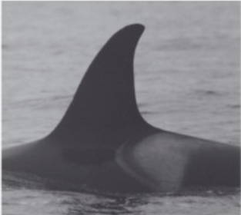
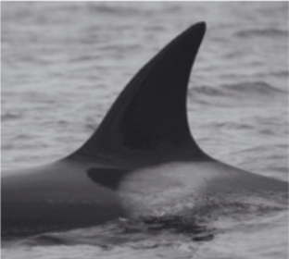


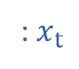
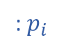

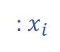
Finite mixture models
: $x_{i}$
: $p_{i}$
: $x_{t}$
Dahlheim et al. 2008
$$X$$
$$Resident$$
Dahlheim et al. 2008
$$Transient$$
Notes:
Let’s begin with an example, where you want to distinguish between resident and transient killer whales.
And we suspect that we could do this by measuring the curvature of the dorsal fin, by calculating the maximum angle made by the leading edge.
The resident and transient orcas represent two possible components or groups an image can represent. What we don’t know is how frequent each group is, that is, what is the overall probability a photo might be of a in the component representing resident or transient whale.
- In this case, the probability of a photo being in component 1 is 0.75, and the prob of being in component 2 is 0.25
We also don’t know the distributions of dorsal fin angles associated with each component.
In this case, component 1 has a lower angle mean and sd than component 2. Component 1 is centred around 15, while component 2 is centred around 25.
What we actually observe are the angles, and after many measurements, we may obtain the overall cumulative density on the right, which again, is a combination of the two hidden components In this case, the first image we process happens to be an individual from component 1, and we obtained a measurement of 14.2. In the next image, it happened to be in component 2, and an observation is drawn from the probability density function of P2, and we obtained a measure of 29.4
In the next measurement it happened to be in component 1, which again we don't know what state it's in, and we measure 8.9, which was drawn from the probability density function associated with component1
And this is repeated for all of our measurement, which ere either drawn from the distribution associated with component 1 or component 2. you'll notice there are many values for example between 10 and 25 that could reasonably come from both distributions
The goal of finite mixture models is to estimate the parameters associated with each component’s probability densities as well as the probability of each component.
Procrasticide: Colour components by colour

Slide 10
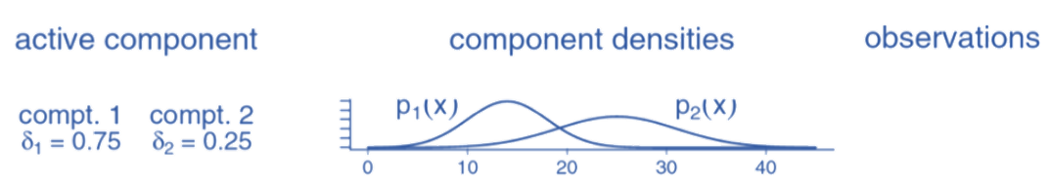
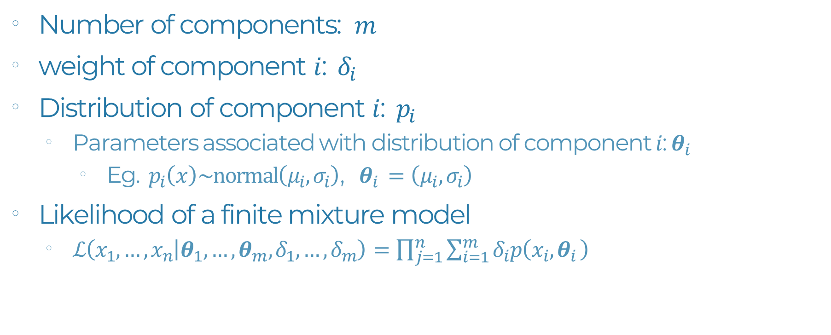
Mixture models: Key parameters
: $x_{i}$
: $p_{i}$
: $x_{t}$
$$X$$
Number of components: $m$
weight of component $i$: $δ_{i}$
Distribution of component $i$: $p_{i}$
Parameters associated with distribution of component $i$: $θ_{i }$
Eg. $p_{i}\left(x\right)\sim normal\left(μ_{i},σ_{i}\right)$, $θ_{i }=\left(μ_{i},σ_{i}\right)$
Likelihood of a finite mixture model
$ℒ\left(x_{1},…,x_{n} | θ_{1},…,θ_{m},δ_{1},…,δ_{m}\right)=\prod_{j=1}^{n}{\sum_{i=1}^{m}{δ_{i}p\left(x_{i},θ_{i }\right)}}$
Notes:
All right, So what are the key parameters that finite mixture models use? The first parameter that's defined by the practitioner is the number of components, or the number of states an observation might come from, and this is represented by the letter m
in this example, there are two components, so m=2.
The second parameter is the weight of each component i, represented by δ_{i}. Such that each component has its own weight.
Together they all sum up to one. Since a the system has to be in some state
The 3rd each component has its own associated probability distribution represented by p_{i} .
next, each distribution is defined by some parameters, which are represented by θ. For example, if the possible measures are normally distributed, we would need to estimate mean and standard deviation parameters for each component.
Again, the researcher defines the number of components, and the finite mixture model would estimate the values of δ and θ
- The parameters are estimated by maximising the likelihood of a finite mixture model. - Is this case, the likelihood is calculating the probability of the observed data (from the first observation x₁ to your last observation x_{n}) given the parameters from each component and the weights of each component delta. In the above example, m is 2, so we only have 2 θs and 2 δs. - the likelihood is calculated by multiplying the probability of each observation given the a components distribution by the weight of that component, then summing across all the different components. For example if we have a measure of 10, we would sum the probability of obtaining 10 from p1 and from p2. and lastly, we would multiply multiplying the cross all the observations, from the first j=1 to the last j=n

Slide 11
Markov CHAINS
Notes:
Excellent. That’s the “hidden” part of hidden markov models, Next, let’s define the “Markov” half.

Slide 12
Hidden Markov models - Solution
Underlying biological process is hidden
Finite mixture model
Latent process is autocorrelated
Markov chain
Notes:
As you recall, the second component of Hidden Markov models is this Markov chain, and that's addressing the auto correlation in the underlying latent state.

Slide 13
Markov chain: Theory
1
2
Notes:
The premise of Markov chains is that the system is in discrete states over time, and the states are autocorrelated, right? For example, a polar bear may we walking at first, then running for some time, then walking again. A Markov chain has two elements, all the possible states or components, and all possible transitions among the components. In this basic Markov chain, we have two possible states (blue and red), we have a probability of remaining within the blue state, the probability of transitioning into the red state, and if the system is in the red state, there is a probability of remaining within the red state, and a probability of transitioning to the blue state.

Slide 14
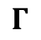
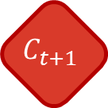
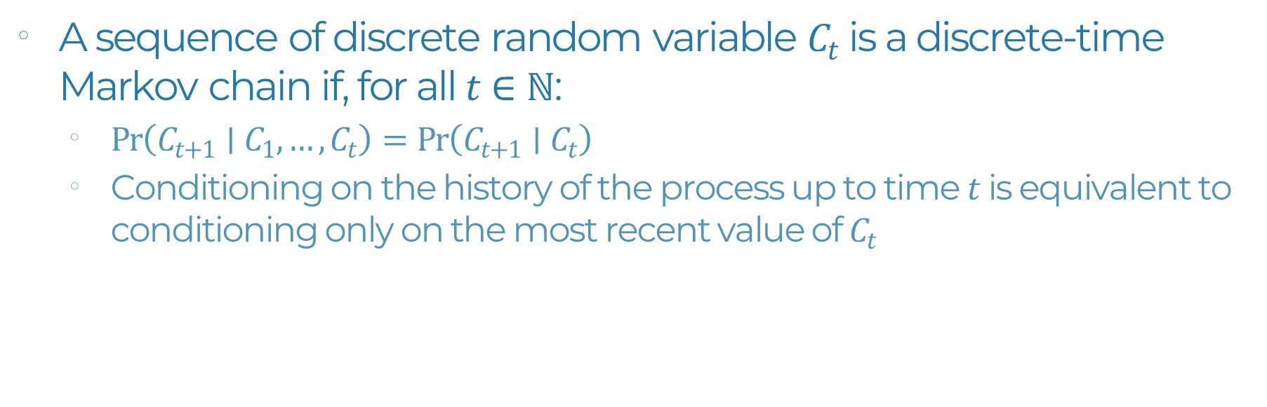
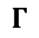

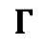

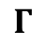
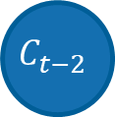
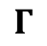
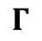
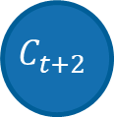
Markov chain: Dependencies
$$C_{t−2}$$
$$C_{t−1}$$
$$C_{t}$$
$$C_{t+1}$$
$$C_{t+2}$$
$$Γ$$
$$Γ$$
$$Γ$$
$$Γ$$
$$Γ$$
$$Γ$$
A sequence of discrete random variable $C_{t}$ is a discrete-time Markov chain if, for all $t∈ℕ$:
$Pr\left(C_{t+1}∣C_{1},…,C_{t}\right)=Pr\left(C_{t+1}∣C_{t}\right)$
Conditioning on the history of the process up to time $t$ is equivalent to conditioning only on the most recent value of $C_{t}$
Notes:
We can say that a sequence of discrete random variable C_{t} is a discrete-time Markov chain if for all time steps, the probability of a component at t + 1, conditioned on the entire history components from t=1 to t
is equal to the probability the of a component at t + 1 conditioned only on the component at time t
in other words, in a Markov chain, conditioning on the entire history of the process up until time t is equivalent to conditioning only on the most recent value of C_{t}
Such that the probability of being in a state at some time step only depends on the state at the previous time step.

Slide 15
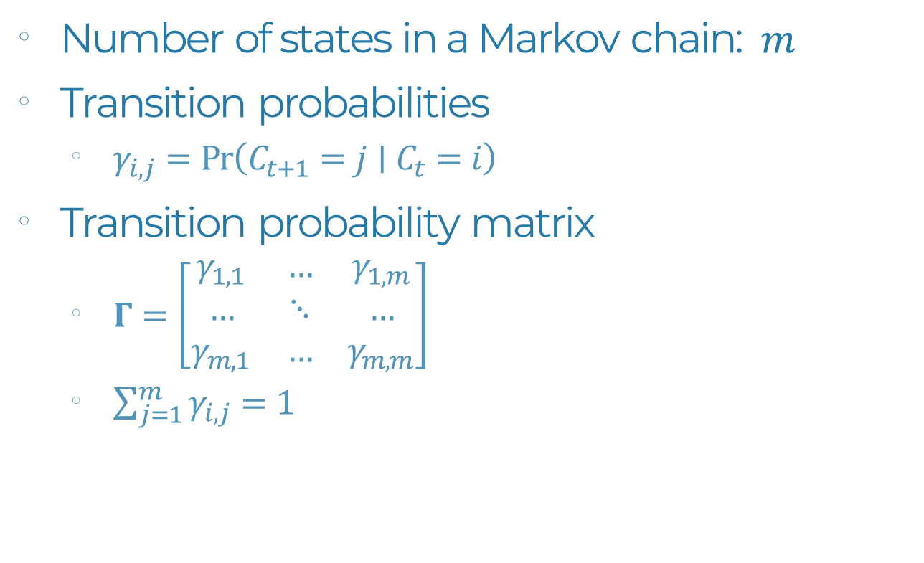
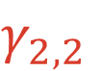
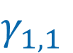
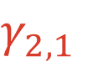
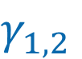
Markov chain: Key parameters
Number of states in a Markov chain: $m$
Transition probabilities
$γ_{i,j}=Pr\left(C_{t+1}=j∣C_{t}=i\right)$
Transition probability matrix
$Γ=\left[\begin{matrix}γ_{1,1} & … & γ_{1,m} \\ … & ⋱ & … \\ γ_{m,1} & … & γ_{m,m}\end{matrix}\right]$
$\sum_{j=1}^{m}{γ_{i,j}}=1$
$$γ_{1,2}$$
1
2
$$γ_{1,1}$$
$$γ_{2,2}$$
$$γ_{2,1}$$
Notes:
There are two key elements defining a Markov chain first, is the number of possible states in the chain, represented by the letter m, and second, is the transition probabilities among all the states. A transition between two states is defined by γ. Where γ_{ij} represents probability the you are in state j at time t+1 given that you were in state i at the previous time step t.
In a basic HMM, we must estimate the γ for staying within each state, and γ for each possible transition between states.
In this case, we have 4 γ parameters.
All the γ can be represented in what’s called the transition probability matrix. In this matrix, each row represents a possible starting state, and each column represents the possible state in the following time step For example, the very first cell, which is row 1 column 1, represents the probability of remaining within state 1. The cell to the right, is the probability of transitioning from state 1 to state 2 the second row represents the probabilities of transitioning from state 2 and so on and so forth up until the last cell, which is the probability of remaining within the final state in your chain, m In other words, this matrix represents the probabilities transitioning from any state to any other state or remaining within the same state.
A key feature of the transition probability matrix, which is represented by the capital letter Γ is that each row must sum to 1. because if you are in some state, you must transition into something else or remain in the same state. However, this is not necessarily true for the states.

Slide 16
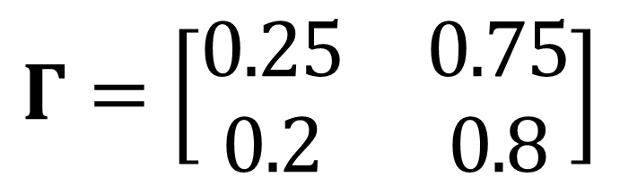
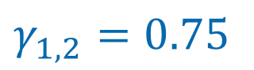
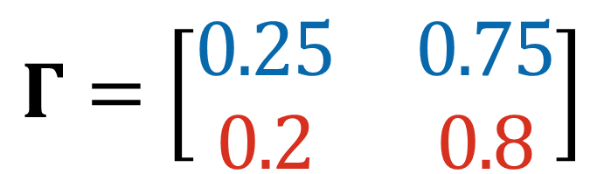
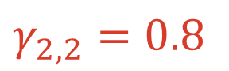
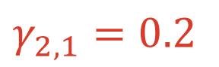
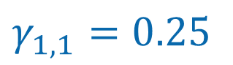
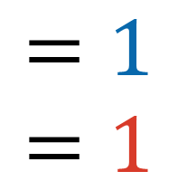
Markov chain: Transition probability
$$γ_{1,2}=0.75$$
1
2
$$γ_{1,1}=0.25$$
$$γ_{2,2}=0.8$$
$$γ_{2,1}=0.2$$
$$Γ=\left[\begin{matrix}0.25 & 0.75 \\ 0.2 & 0.8\end{matrix}\right]$$
$$\begin{matrix}=1 \\ =1\end{matrix}$$
$$Γ=\left[\begin{matrix}0.25 & 0.75 \\ 0.2 & 0.8\end{matrix}\right]$$
Notes:
This is best illustrated with an example. Here, we have a two-state Markov chain, where there is a 25% probability of remaining within a blue state and a 75 transitioning out of it to the red state. And for the red state, there’s an 80% probability of remaining within the state, and a 20% probability of transitioning into the blue state. Here, the blue gamma’s must add up to 1 and the red gammas must add up to 1. The transition probability matrix for this Markov chain would look like this: Again, the first row is the transitions from state one and the 2nd row is the transitions from state two. The first column is the transitions into state one. And the second column is the transitions into State 2, Here, the first cell here is the probability of remaining within state 1, which is 25%, the next column is the probability of transitioning into state 2, which is 75% Likewise for the red, the first column is the 20% probably of transitioning into state 1 and the last cell is the 80% probability of remaining within state 2. You can see here how each row must sum up to one, while this is not the case for the columns, which is totally fine.

Slide 17
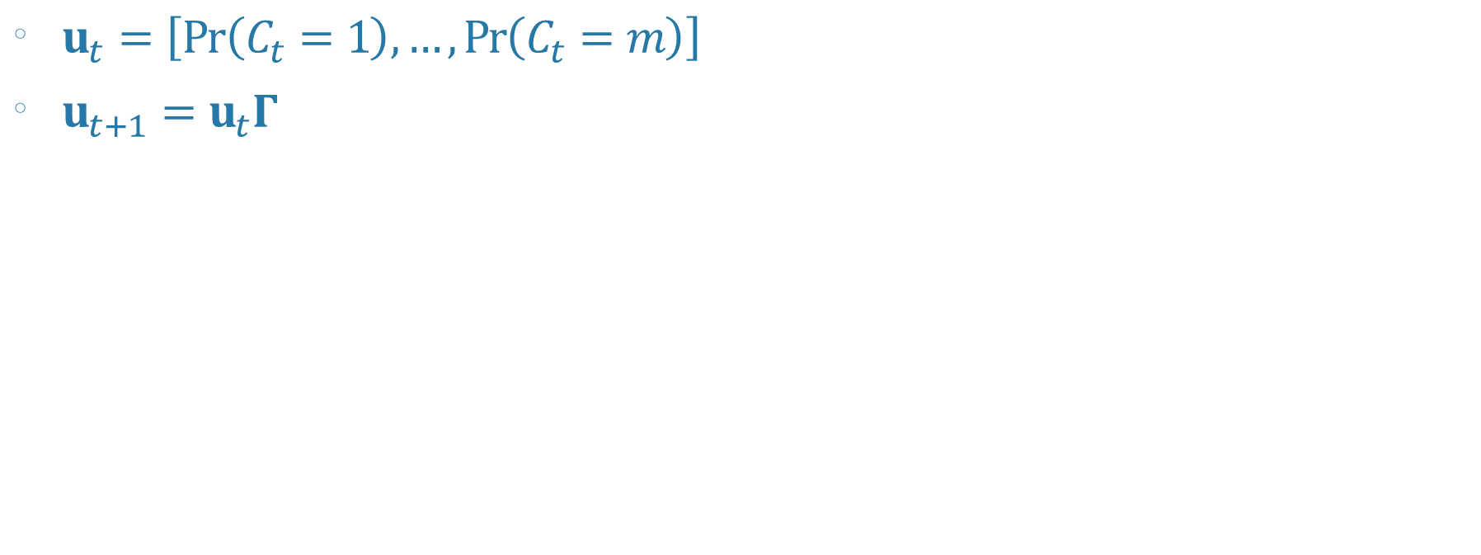
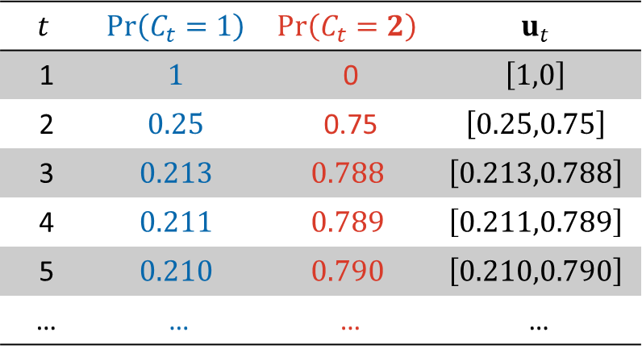
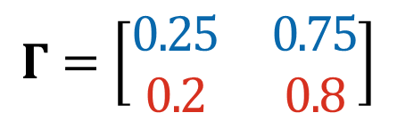
Markov chain: Unidirectional probabilities
$$Γ=\left[\begin{matrix}0.25 & 0.75 \\ 0.2 & 0.8\end{matrix}\right]$$
$u_{t}=\left[Pr\left(C_{t}=1\right),…,Pr\left(C_{t}=m\right)\right]$
$u_{t+1}=u_{t}Γ$
1
2
$$t$$ | $$Pr\left(C_{t}=1\right)$$ | $$Pr\left(C_{t}=2\right)$$ | $$u_{t}$$
1 | $$1$$ | 0 | $$\left[1,0\right]$$
2 | $$0.25$$ | 0.75 | $$\left[0.25,0.75\right]$$
3 | $$0.213$$ | $$0.788$$ | $$\left[0.213,0.788\right]$$
4 | $$0.211$$ | $$0.789$$ | $$\left[0.211,0.789\right]$$
5 | $$0.210$$ | $$0.790$$ | $$\left[0.210,0.790\right]$$
… | … | … | …
Notes:
The handy thing about storing the gamma probabilities in a matrix is that we can use matrix multiplication. If we define u(t) as a vector containing the probabilities of being in each of the possible states at time t, then we can calculate u at time t+1 by simply multiplying u_{t} by the transition probability matrix This is best illustrated with an example.
If we use the same markov chain as before. Let’s assume that at time 1, we know the system is in state 1. then u_{t} is the vector 1 comma 0, to estimate the probabilities for each state at time 2, we can multiply u₁ by gamma, and we see (as expected), there is a 25% chance we will remain in state 1 and 75% chance we will transition into state 2. so, at time 2, u₂ is 0.25 comma 0.75
Next, we multiply this by gamma to estimate the state probabilities at time 3 to be 0.213 and 0.788,
And we repeat this to estimate the probabilities at time 4, 5, and so on.

Slide 18
HIDDEN MARKOV MODELS
Notes:
Last, we have both elements needed to define the hidden markov model: finite mixture models, and markov chains.

Slide 19
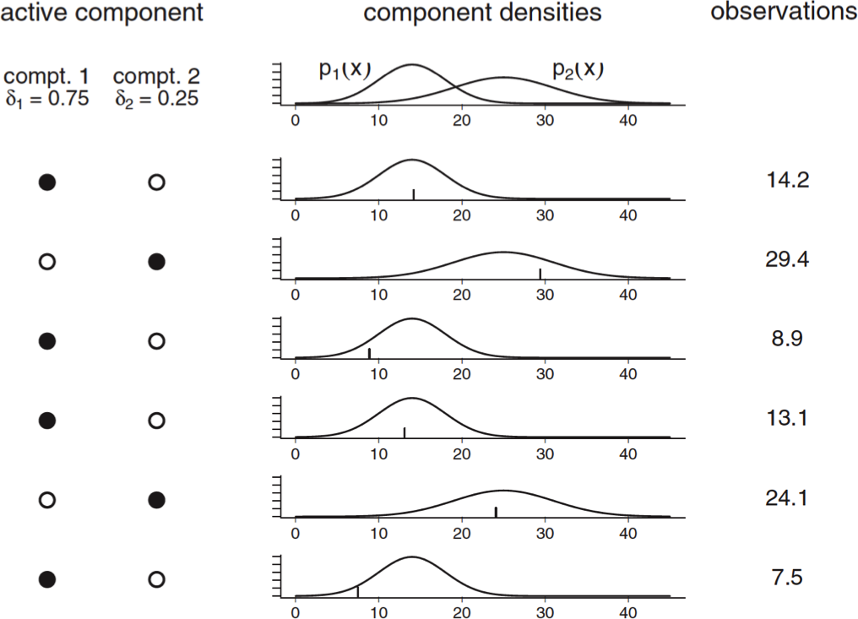
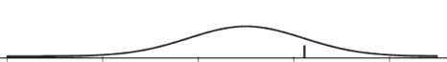
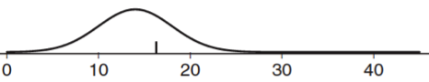
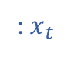
HMM: Finite mixture model
Mixture model where the weights are defined by a Markov chain
: $x_{t}$
1
2
Notes:
Simply put, a hidden markov model is a mixture model where the weights are defined by a markov chain. As you recall, a mixture model states there are some finite number of components, each with their own
Respective weights and emission probability distributions

Slide 20
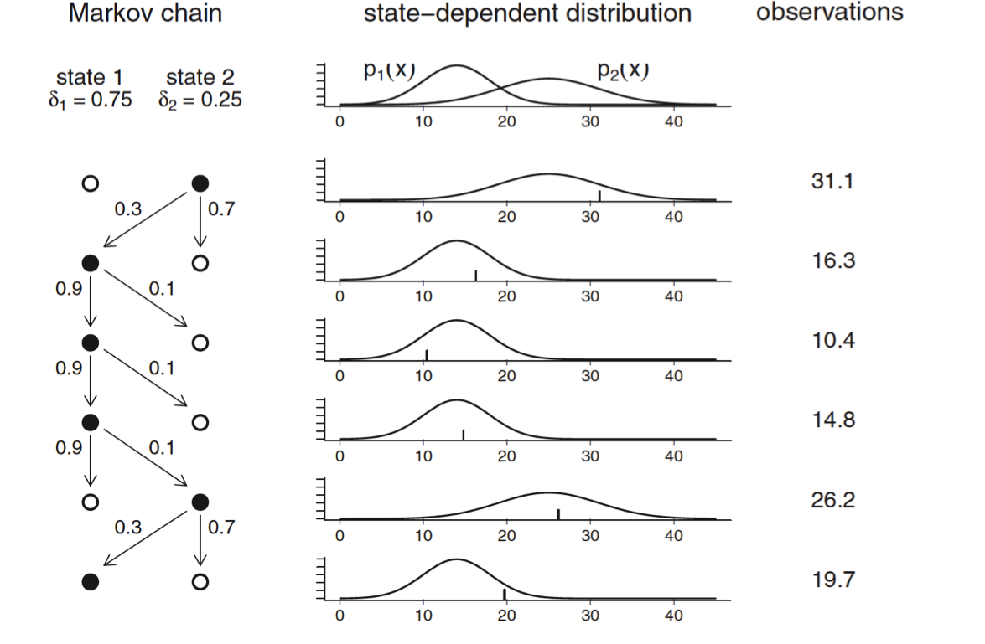
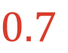



HMM: Markov chain
Mixture model where the weights are defined by a Markov chain
: $x_{t}$
$$0.1$$
1
2
$$0.9$$
$$0.7$$
$$0.3$$
Notes:
Hidden Markov models build on this by specifying that the states are actually dependent on each other in time following a Markov chain, wherein, each state has a probability to remain within the same state or transition to another state. From the example on the right, the system begins in state 2, which has a corresponding state-dependent distribution that produces the first observation of 31. In the following time step, the state transitions into state 1 from which we obtain an observation of 16.
The following state transitions are governed by the markov chain, and the emission probabilities are governed by the state-dependent distribution.
this example, we see the the probability of remaining in state 1 is 90%, and the probability of transitioning to state 2 is 10%.
For the second state, there is a probability of 70% of remaining within the same state and a 30% probability of transitioning to state 1.

Slide 21

HMM: Key parameters
Number of states: $m$
State probability: $Pr\left(C_{t}∣C_{t−1}\right)$
Emission probability: $Pr\left(x_{t}∣C_{t}\right)$
State dependent distribution: $Pr\left(X_{t}=x∣C_{t}=i\right)=p_{i}\left(x\right)$
$P(x)=\left[\begin{matrix}p_{1}(x) & … & 0 \\ … & ⋱ & … \\ 0 & … & p_{m}(x)\end{matrix}\right]$
$u_{t}=\left(Pr\left(C_{t}=1\right),…,Pr\left(C_{t}=m\right)\right)$
$u_{t}P\left(x\right)1^{′}=Pr\left(X_{t}=x\right)$
Notes:
Now let’s define the key parameters of an HMM: As before, the number of states is defined by the practitioner and is denoted by the letter m. The state probability at time t given the state at time t-1 is represented as follows. The emission probability is defined as the probability of observation x at time t given the latent state at time t. The state dependent distribution represents the state-specific probability of observation x.
Specifically, the probability of that at time t we observed the value x, assuming we were in state I is represented by probability p for state i for observation x
Next, we can define capital P of x as a diagonal matrix for the probability of observation x for each state from 1 to m.
This diagonal matrix represents all the ways we may observe x
If you recall, we previously defined u_{t} as the vector of probabilities of being in each of the possible states from 1 to m.
And multiplying u_{t} by P(x) and a column vector of 1s, gives us the overall probability of observing x at time t given all the possible states we may be in given their respective probabilities. X at time t. We multiply by a column vector of 1s in effect so sum the state-dependent probabilities to obtain one value of observation x

Slide 22

HMM: Likelihood
$ℒ=∏_{t=1}^{T} P(x_{t})$
Does NOT work because $Pr\left(X_{t}=x\right)$ is dependent on $Pr\left(X_{t−1}=x\right)$
$ℒ=δP\left(x_{1}\right)ΓP\left(x_{2}\right)…ΓP\left(x_{T}\right)1^{′}$
$δ=u_{t=1}$
$ℒ=δP\left(x_{1}\right)\prod_{t=2}^{T}{ΓP\left(x_{t}\right)1^{′}}$
Notes:
Finally, we can put everything together to obtain the HMM likelihood. Our first instinct might be to simply take the probabilities of each observation x from t = 0 to the final observation T,
However, this cannot work, because it doesn’t account for the autocorrelation in the latent state. That is the probability of making an observation x at time t is dependent on the observation at t-1 through the autocorrelated hidden state.
The actual likelihood of the Hidden Marko model. We begin with the state distribution at time t=1. this is equivalent to U_{t=1}, which we defined earlier as the vector of state probabilities, next, we multiply this by the emission probability matrix given the first observation to calculate the cumulative probability of the first observation, then we multiply by transition probability matrix gamma, to calculate the state probability in the following step.
Next, we multiply again by the emission probability matrix given observation 2, then again by gamma, and P recursively until the last observation.
We again conclude by multiplying by a column vector of 1s to obtain one value that represents the overall HMM likelihood.
Given all the repetition in this likelihood, it can be written more sucintly as follows. The likelihood is equal to the initial state distribution times emission probability for observation 1, then multiply this recursively by the state transition matrix and emission probability for each observation from time t=2 to the final time step, and conclude again by multiplying by a column vector of 1s.

Slide 23
Polar Bear Case Study
Notes:
To give you a concrete example of the application of HMMs, The rest of this presentation will describe how I applied them during my PhD to investigate polar bear behavioural ecology.

Slide 24

Ch. 4
24
© Wayne Lynch
Notes:
Polar bears rely on sea ice for access to their primary prey, ringed seals and bearded seals

Slide 25



TEMPERATURE
DAHLHEI
SEA ICE .
NSIDC 2021
Notes:
However, due to increasing global temperatures over the past several decades, sea ice extent and volume have both been decreasing.
This decreases the available area for PBs to access seals, and also shortens the winter foraging season as ice freezes up later and breaks up earlier.
As the environment changes, it is critical to Identify the environmental conditions PBs rely on for foraging.

Slide 26

© Ron Togunov
Notes:
Polar bear’s sea ice environment is vast, complex, and dynamic, and makes visual search alone is inadequate for locating prey.
For eg, Pressure ridges can account for up to 40% of sea ice volume and have a mean height of 2m, creating significant visual barriers.

Slide 27


Polar Bear Olfaction
Togunov et al. 2017. Scientific reports
Notes:
therefore, polar bears rely greatly on olfaction to locate prey.
In the presence of wind, Odors produced by seals are carried downwind in an odour plume.
If a bear smells a seal, it should travel upwind to locate the source.
However, if bears have no information on prey distribution, theory suggests that they should *** move cross-wind to max chance of encountering an odor plume.

Slide 28








Movement in moving environments
20°
NASA 2018
Notes:
there are additional challenges when studiyng animals in moving environments such as polar bears on the moving sea ice.
One of the big challenges is that moving environments affect the apparent motion of the animal.
Such that, As the animal moves through the environment, the environment also moves the animal. As a result, the overall movement we observe from tracking data is the comb of voluntary mvmt by the animal and involuntary mvmt imparted onto them by the environment.

Slide 29









Polar bear behaviour
Togunov et al. 2021. Methods in Ecology and Evolution
Notes:
I used polar bears as a case study to identify three behavioural states:
First, when the bears are stationary and passively drifting on the sea ice (for example, if still-hunting by a breathing hole or resting), their movement occurs at a slight angle to the right of wind due to the Earth’s rotation.
2nd. During OS, bears are assumed to move roughly crosswind
& 3rd, during area restricted search mvmt is assumed to be independent of wind

Slide 30





Remote tracking
GPS Track
100% ice
50% ice
0% ice
Notes:
To get at behaviour, my thesis relied on location data obtained from GPS collars deployed on female bears.

Slide 31


Notes:
This animation depicts the motion of one female bear in 2011.

Slide 32










HMM: Behaviour from movement
Markov chain:
Hidden state:
$$P\left(x_{t−2}\right)$$
$$P\left(x_{t−1}\right)$$
$$P\left(x_{t}\right)$$
$$P\left(x_{t+1}\right)$$
$$P\left(x_{t+2}\right)$$
$$l_{t−2}$$
$${\text{ϕ}}_{t−2}$$
$$l_{t−1}$$
$${\text{ϕ}}_{t−1}$$
$$l_{t}$$
$${\text{ϕ}}_{t}$$
$$l_{t+1}$$
$${\text{ϕ}}_{t+1}$$
$$l_{t+2}$$
$${\text{ϕ}}_{t+2}$$
Observation:
ϕ
l
Togunov et al. 2021. Methods in Ecology and Evolution
Notes:
As you may have guessed, I used HMMs to help identify behaviours from the tracking data.
As a review, the true behaviours of the bear was assumed to be discrete states that are hidden and not observed.
And the probability of being in a given state at some time depends on the state the animal was in during the previous step as described by a Markov chain.
From the GPS tracking data, I obtained movement metrics, as step length and turning angle, which were assumed to be probabilistically dependent on the underlying state.
To bring in the notation from the lecture, the transition probability matrix is represented by the arrow between states,
And the emission probability, P of x is represented by the arrows to the observed data streams.

Slide 33












Basic HMM
$$l_{t}$$
$${\text{ϕ}}_{t}$$
Notes:
In a basic HMM, where I have area restricted search and olfactory search, I may expect that area restricted search would be characterised by slower step lengths and higher turn angle, and olfactory search to have higher movement speed and more concentrated movement.

Slide 34




Case study HMM
Markov chain:
Hidden state:
Observation:
$$φ_{t}$$
l_{t}
$$φ_{t}=φ_{t−1}+ α1\left(ψ\right)$$
Togunov et al. 2021. Methods in Ecology and Evolution
$φ_{t}=φ_{t−1}+ α1\left(ψ\right)$ + $α_{2}\left(ψ+90°\right)$
Notes:
To investigate additional behaviours, I made several extensions to the basic HMM.
First, I included an additional 3rd state representing any stationary behaviours where the bear would be passively drifting.
To help identify crosswind olfactory search, I needed to incorporate orientation relative to wind.
To do this, I modelled the observed data streams as functions of environmental covariates. For example, modelling turning angle as a function of wind.

Slide 35






Menotactic BCRW
$φ_{t}=φ_{t−1}+ α1\left(ψ\right)$ + $α_{2}\left(ψ+90°\right)$
Animal track
ϑ
$$φ_{t}$$
Stimuli direction (eg. wind)
$$α_{2}$$
$$α_{1}$$
Angle of attraction
$$ψ$$
Persistence
Persistence
Bias coefficients
Togunov et al. 2021. Methods in Ecology and Evolution
Notes:
movement with an angled bias relative to external factors such as cross-wind olfactory search is known as menotaxis.
To model mvmt *** w/ angled bias relative to external factors (eg wind), I developed a menotactic BCRW model.
The model described *** turning angle as a trade-off between directional persistence, bias par to stimulus and perp to stimulus
This framework does not make any assumptions about the angle or magnitude of orientation bias. The model can Describe mvmt purely correlated, biased, or as a B & CRW, with bias toward any angle relative to the stimulus.

Slide 36








Extensions to Markov chain
30 min
1 hour
Togunov et al. 2021. Methods in Ecology and Evolution
Notes:
I had to make 2 additional modifications to the markov chain:
1st during OS, bears would generally maintain one direction relative to wind (either left or right), this is best represented with two discrete states (OSL & OSR). 2nd, when bears are stationary and drifting w/ ice, their motion is primarily driven by wind, however, because wind is autocorrelated, the bear movement can look more like a misclassified as a CRW with no bias to wind. However, the first step of D is independent of the previous step and should exhibit a bias relative to wind. …, I divided D into 2 states: Trans-to-D (left) and consequent D steps (R).
If a bear is in the TD state, they must trans into the CD state. But they can remain within the other states.
While CD can trans’ into OS or ARS
Finally, OS and ARS could transition b/w each other or into TD
This framework is particularly important when traking data is at a higher resolution than the environment data. In this case, the collars had a 30m res’ compared to the 1h res’ wind data.

Slide 37

HMM: Covariates on state transition
Togunov et al. 2022. In review
Notes:
Next, I was interested in also using HMMs to model the effects of environmental conditions on polar bear behaviour.
HMMs are well suited for this as we can model the state transition probabilities as functions of covariates.
For example, we may expect high ice concentrations to increase the transition probability to area restricted search and low ice concentrations to increase the probability of other olfactory search.

Slide 38

Results: Transitionary drift state
Togunov et al. 2021. Methods in Ecology and Evolution
Notes:
This map show the behavioural states predicted by the model (black lines represent wind vectors) In orange and red, we see OS left and right of wind, respectively, and in blue is the drift state.
The plot also illustrates how autocorrelated drift can appear, and how bias relative to wind is exhibited primarily by the first drift step.

Slide 39






Results: State probability
Togunov et al. 2022. In review
Notes:
My analysis identified 6 covariates that significantly affected state probability.
Hour, date, ice con., dist to shore, wind speed, and bear age.
For brevity, I’ll just interpret the results for hour.

Slide 40




Results: Hour
Hamilton et al. 2018
Haul-out
© EPA/Baard Ness
© Brent Young
State Probability
©Jami Tarris
© Theo Allofs
Togunov et al. 2022. In review
Hour
Notes:
The main pattern observed was that during the early hours of the day, PBs were likely to be in the stationary behaviours, and as the day progressed they were more likely to exhibit active OS.
This nicely mirrored the known patterns of seal haul-out behaviour.
during the colder night and early hours, seals are more likely to remain in the water and only surface to breathe, which may favour still-hunting.
Conversely, as temperatures increase during the day, seals are more likely to haul-out, which may favour stalking and active predation.

Slide 41


Results: State distribution & ice concentration
Core Range
2018-20
2011,17,21
<7 days
Togunov et al. 2022. In review
Notes:
Last, I looked at the spatial distribution of different behaviours with respect to the core range and the summering ground (shown in green).
The main pattern I observed was that the bears were more likely to engage in more resident behaviour in the core range, and more active behaviours near the outer limits of their range.
In addition, I compared the distribution in years with high and low ice concentration.
Most notably, in years with high ice concentration, polar bears primarily stayed within their core range,
and in years w/ low ice con, bears ranged further from the core range.
This may be either due to them moving further in search of quality habitat, or the more dynamic sea ice causing them to drift further from their core range.

Slide 42








Other applications
Notes:
Hidden Markov models are very flexible and extendable. Some of the work I presented could for example be applied to investigate sea turtle navigation relative to magnetic fields or flight of seabirds relative to winds and anthropogenic factors such as wind turbines or fishing vessels.

Slide 43
Time to prepare for the workshop!

